Slide 1

Adolescent loneliness in China
—The intertwining relationship between cultural pressure and online weak ties that contributes to social isolation
Presented by Margaret Liu

Slide 2
RESEARCH QUESTION
To what extent is adolescent loneliness in China driven by the cultural pressure of conditional belonging and weak online social ties?

Slide 3
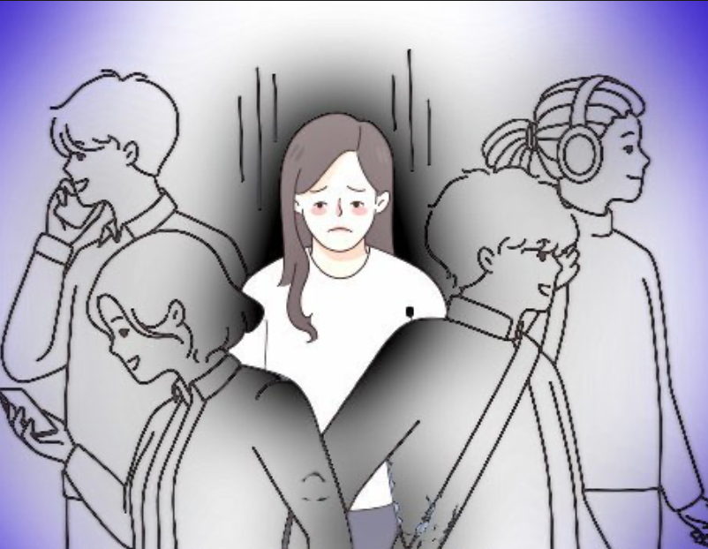
SIGNIFICANCE
Lacking social connection = smoking 15 cigarettes a day (Case, et al., 2023)
Severe mental and physical consequences
Adolescents most prevalent (World Health Organization, 2025).
25% adolescents in China experience loneliness (Hu et al., 2025)

Slide 4
Cultural pressure — Conditional belonging
& Expectation
Microsystem:
Family and School
（Main social cycle)
Family
Confucian Values (displine, success) &
Parental Expectation
Academic success ➡️ pressure, expectation， not being understood
Performance evaluation > emotional support (Xu et al., 2024).
School
Conditional Validation
Approval contingent on grades
Peers and teachers
Marginalization for those who struggle academically.
High restraint culture
Societies that emphasize restraint over indulgence
Higher levels of loneliness
Achievement and social performance
(Jefferson et al., 2023)

Slide 5
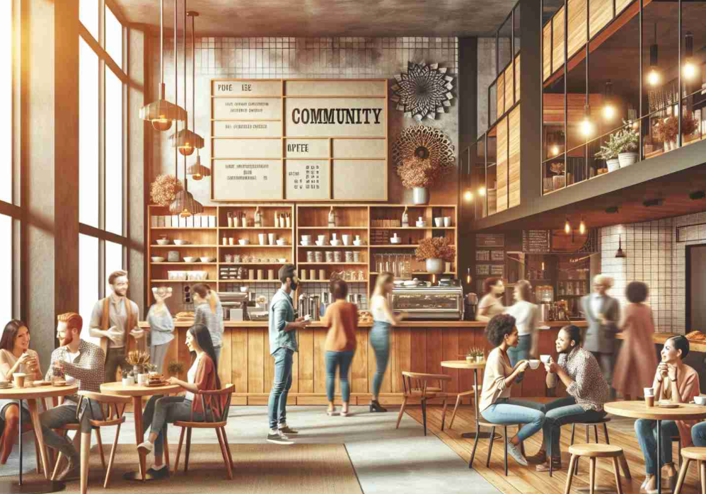
Third place?
A micro community outside home and workplace (school) that is effective in creating social bonds
Task-oriented, transaction-based, gentrification (Ferreira et al., 2021)
Chinese culture - avoid spontaneous interaction with strangers
Prefer connecting within established social circles (Yang et al., 2021).

Slide 6

Escaping to online social— vicious cycle
Search for connection online social platforms (WeChat, Tiktok)
More inclusive, fragmented interaction
Weak Ties (Granovetter, 1973)
Online interactions = "weak ties"
casual, informational, and performative.
lack the emotional depth
Vicious Cycle:
Lonely individuals prefer online interaction➡️
Avoid face-to-face connection➡️ Deeper loneliness
(Caplan, 2007).

Slide 7
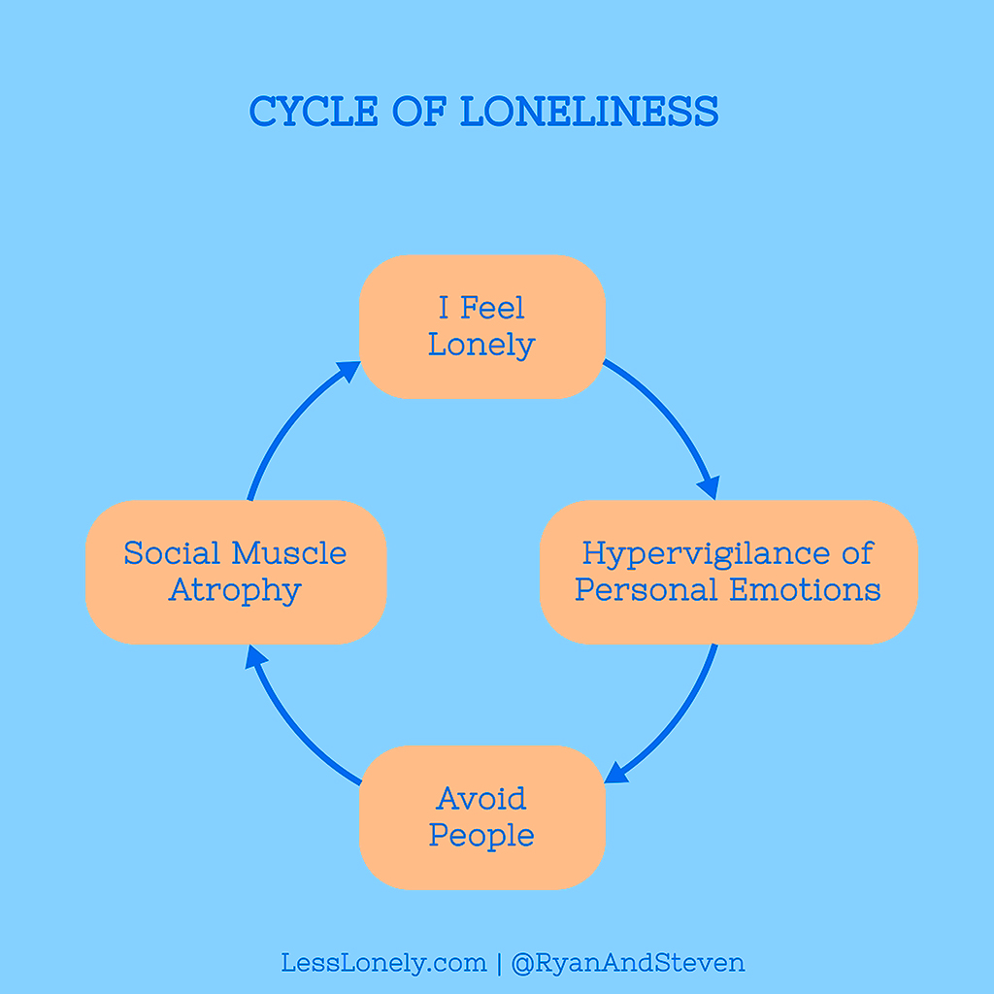
Vicious cycle
Avoid face-to-face connection with people
Only temporary escape
BUT actually intensify loneliness!

Slide 8
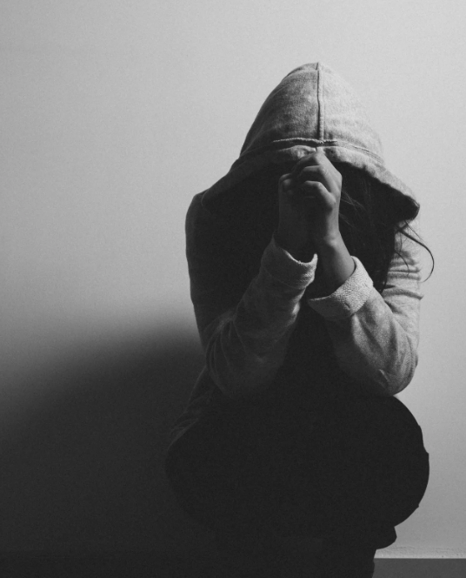
Consequences Of
Adolescent Loneliness
Physical: diminished sleep quality
Mental：depression, anxiety, higher suicide tendency
Lifelong impact:
Hinders secure attachment style development in adolescence
Trouble in forming healthy relationships in adulthood (Mikulincer & Shaver, 2007).

Slide 9

Conclusion
Loneliness in Chinese adolescents is a structural and systematic problem
(Deeply embedded)
Structural change:
holistic development
Individual awareness of the vicious cycle

Slide 10
Works Cited
Caplan, S. E. (2007). Relations Among Loneliness, Social Anxiety, and Problematic Internet Use. CyberPsychology & Behavior, 10(2), 234–242. https://doi.org/10.1089/cpb.2006.9963
Case, B., Corbin, I. M., Teubner, J. D., Cowden, R. G., Bachiochi, E., Cratty, F., & VanderWeele, T. J. (2023). A Supplement to the Surgeon General’s Advisory “Our Epidemic of Loneliness and Isolation.” https://doi.org/10.31235/osf.io/y4pqx
Ferreira, J., Ferreira, C., & Bos, E. (2021). Spaces of consumption, connection, and community: Exploring the Role of the Coffee Shop in Urban Lives. Geoforum, 119(1), 21–29. https://doi.org/10.1016/j.geoforum.2020.12.024
Granovetter, M. S. (1973). The Strength of Weak Ties. American Journal of Sociology, 78(6), 1360–1380. https://www.jstor.org/stable/2776392
Hu, W., Feng, X., Cao, W., Li, J., Luo, S., Lin, L., Chen, D., Chen, W., & Guo, V. Y. (2025). Loneliness and health-related quality of life in Chinese adolescents: the mediating role of depressive symptoms and the moderating role of age. Social Psychiatry and Psychiatric Epidemiology, 60(9), 2201–2211. https://doi.org/10.1007/s00127-025-02834-2
Jefferson, R., Barreto, M., Frederick Robertson Jones, Conway, J., Chohan, A., Katrine Rich Madsen, Verity, L., Petersen, K. J., & Qualter, P. (2023). Adolescent loneliness across the world and its relation to school climate, national culture and academic performance. British Journal of Educational Psychology, 93(4). https://doi.org/10.1111/bjep.12616
Mikulincer, M., & Shaver, P. (2007). APA PsycNet. Psycnet.apa.org. https://psycnet.apa.org/record/2007-12400-000
Xu, T., Zuo, F., & Zheng, K. (2024a). Parental Educational Expectations, Academic Pressure, and Adolescent Mental Health: An Empirical Study Based on CEPS Survey Data. International Journal of Mental Health Promotion, 26(2), 93–103. https://doi.org/10.32604/ijmhp.2023.043226
Yang, X., Hou, J., & Arth, Z. W. (2021). Communicating in a proper way: How people from high-/low-context culture choose their media for communication. International Communication Gazette, 83(3), 174804852090261. https://doi.org/10.1177/1748048520902617

